Slide 1
Children’s Safety Center Safe Kids Southeast Wisconsin
September 15, 2022

Slide 2
Children’s Safety Center
Injury Prevention Program Areas:
5 Program Managers
Children’s Wisconsin (Milwaukee and Fox Valley campus)
Children’s Car Seat Services and Primary Care
Safe Kids Southeast Wisconsin (Community Programming)
Safe Kids Wisconsin (Advocacy and Statewide)
Department of Transportation Child Passenger Safety Program Contract
1 Program Coordinator
Community Services Transporter Training and Car Seat Services
New website:
Safety Center | Children's Wisconsin
Notes:
The injury prevention team at Children’s has shifted a bit over the last year, but our focus has not changed. We still strive to prevent injuries in the community, the region and across the state of Wisconsin. We now have all fulltime staff, with 5 program managers and 1 program coordinator. We have a new fresh look with our name and website.

Slide 3
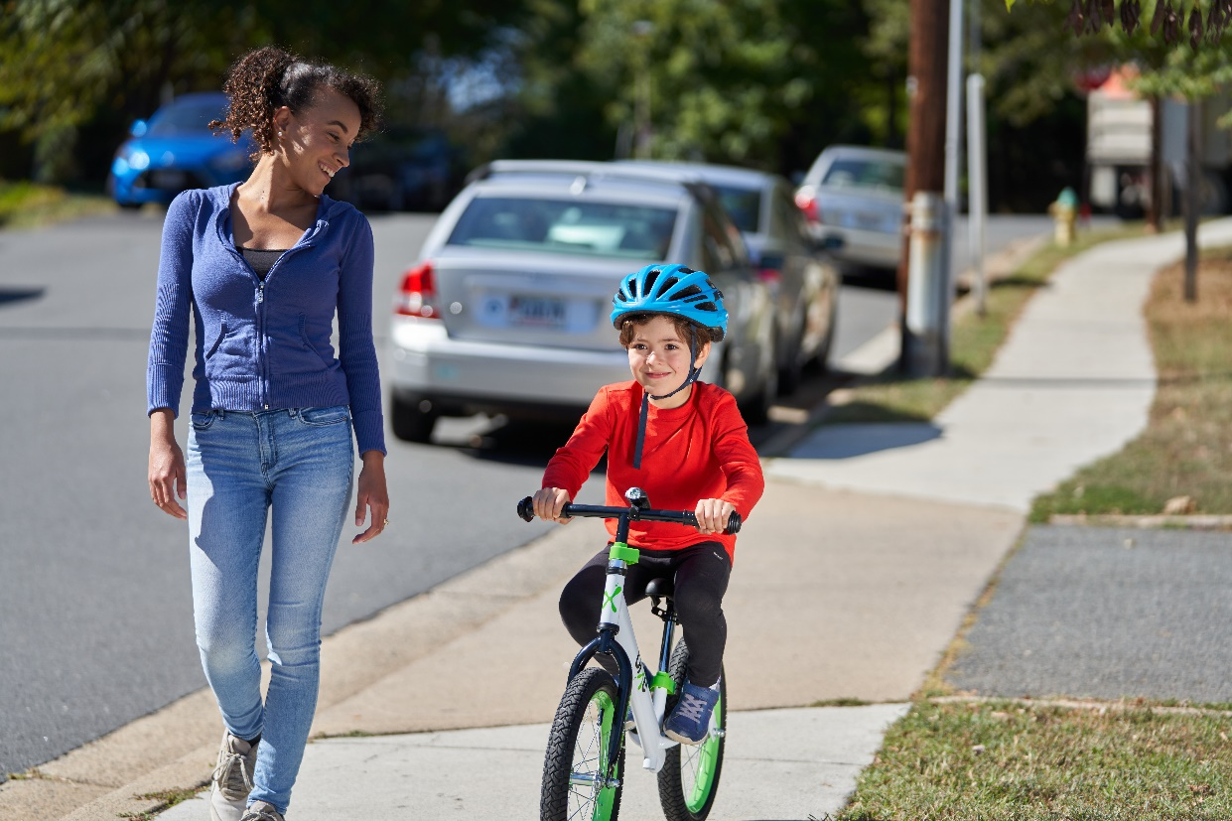
Safe Kids Southeast Wisconsin
New Program Manager
Ashley Tracy
Community and Data Driven
Focus Areas:
Child Passenger Safety
Teen Driving
Fire Prevention
Pedestrian Safety
Bike and Helmet Safety
Home Safety
Other???
Notes:
The Safe Kids Southeast Wisconsin Program has not changed. We will still take a community and data driven approach to the injury prevention areas we focus on. The areas are listed, with many of them being the same as in prior years. Give examples of programs and events for each of these categories.

Slide 4
Safe Kids Southeast Wisconsin
Teen Driving
Impact Teen Drivers Campaigns
Impact Teen drivers Training
Trunk Junk
Other Ideas???
Children’s Wisconsin Teen Driving website: Teen driving | Children's Wisconsin
Wisconsin Impact Teen Drivers website: Wisconsin – Impact Teen Drivers
Possible: Pop-Up Safety Towns
Car seat and bike/helmet safety program for children in at risk community programs
Notes:
The program area that you may not be as familiar with is teen driving. Prior to this year, teen driving was a separate program for the injury prevention team. With Carissa’s resignation, it was decided to fold teen driving into the coalition work. This program has funding for staffing through the Department of transportation and program funding from State Farm Insurance, so will have a stronger focus of the coalition with activities and events planned.

Slide 5
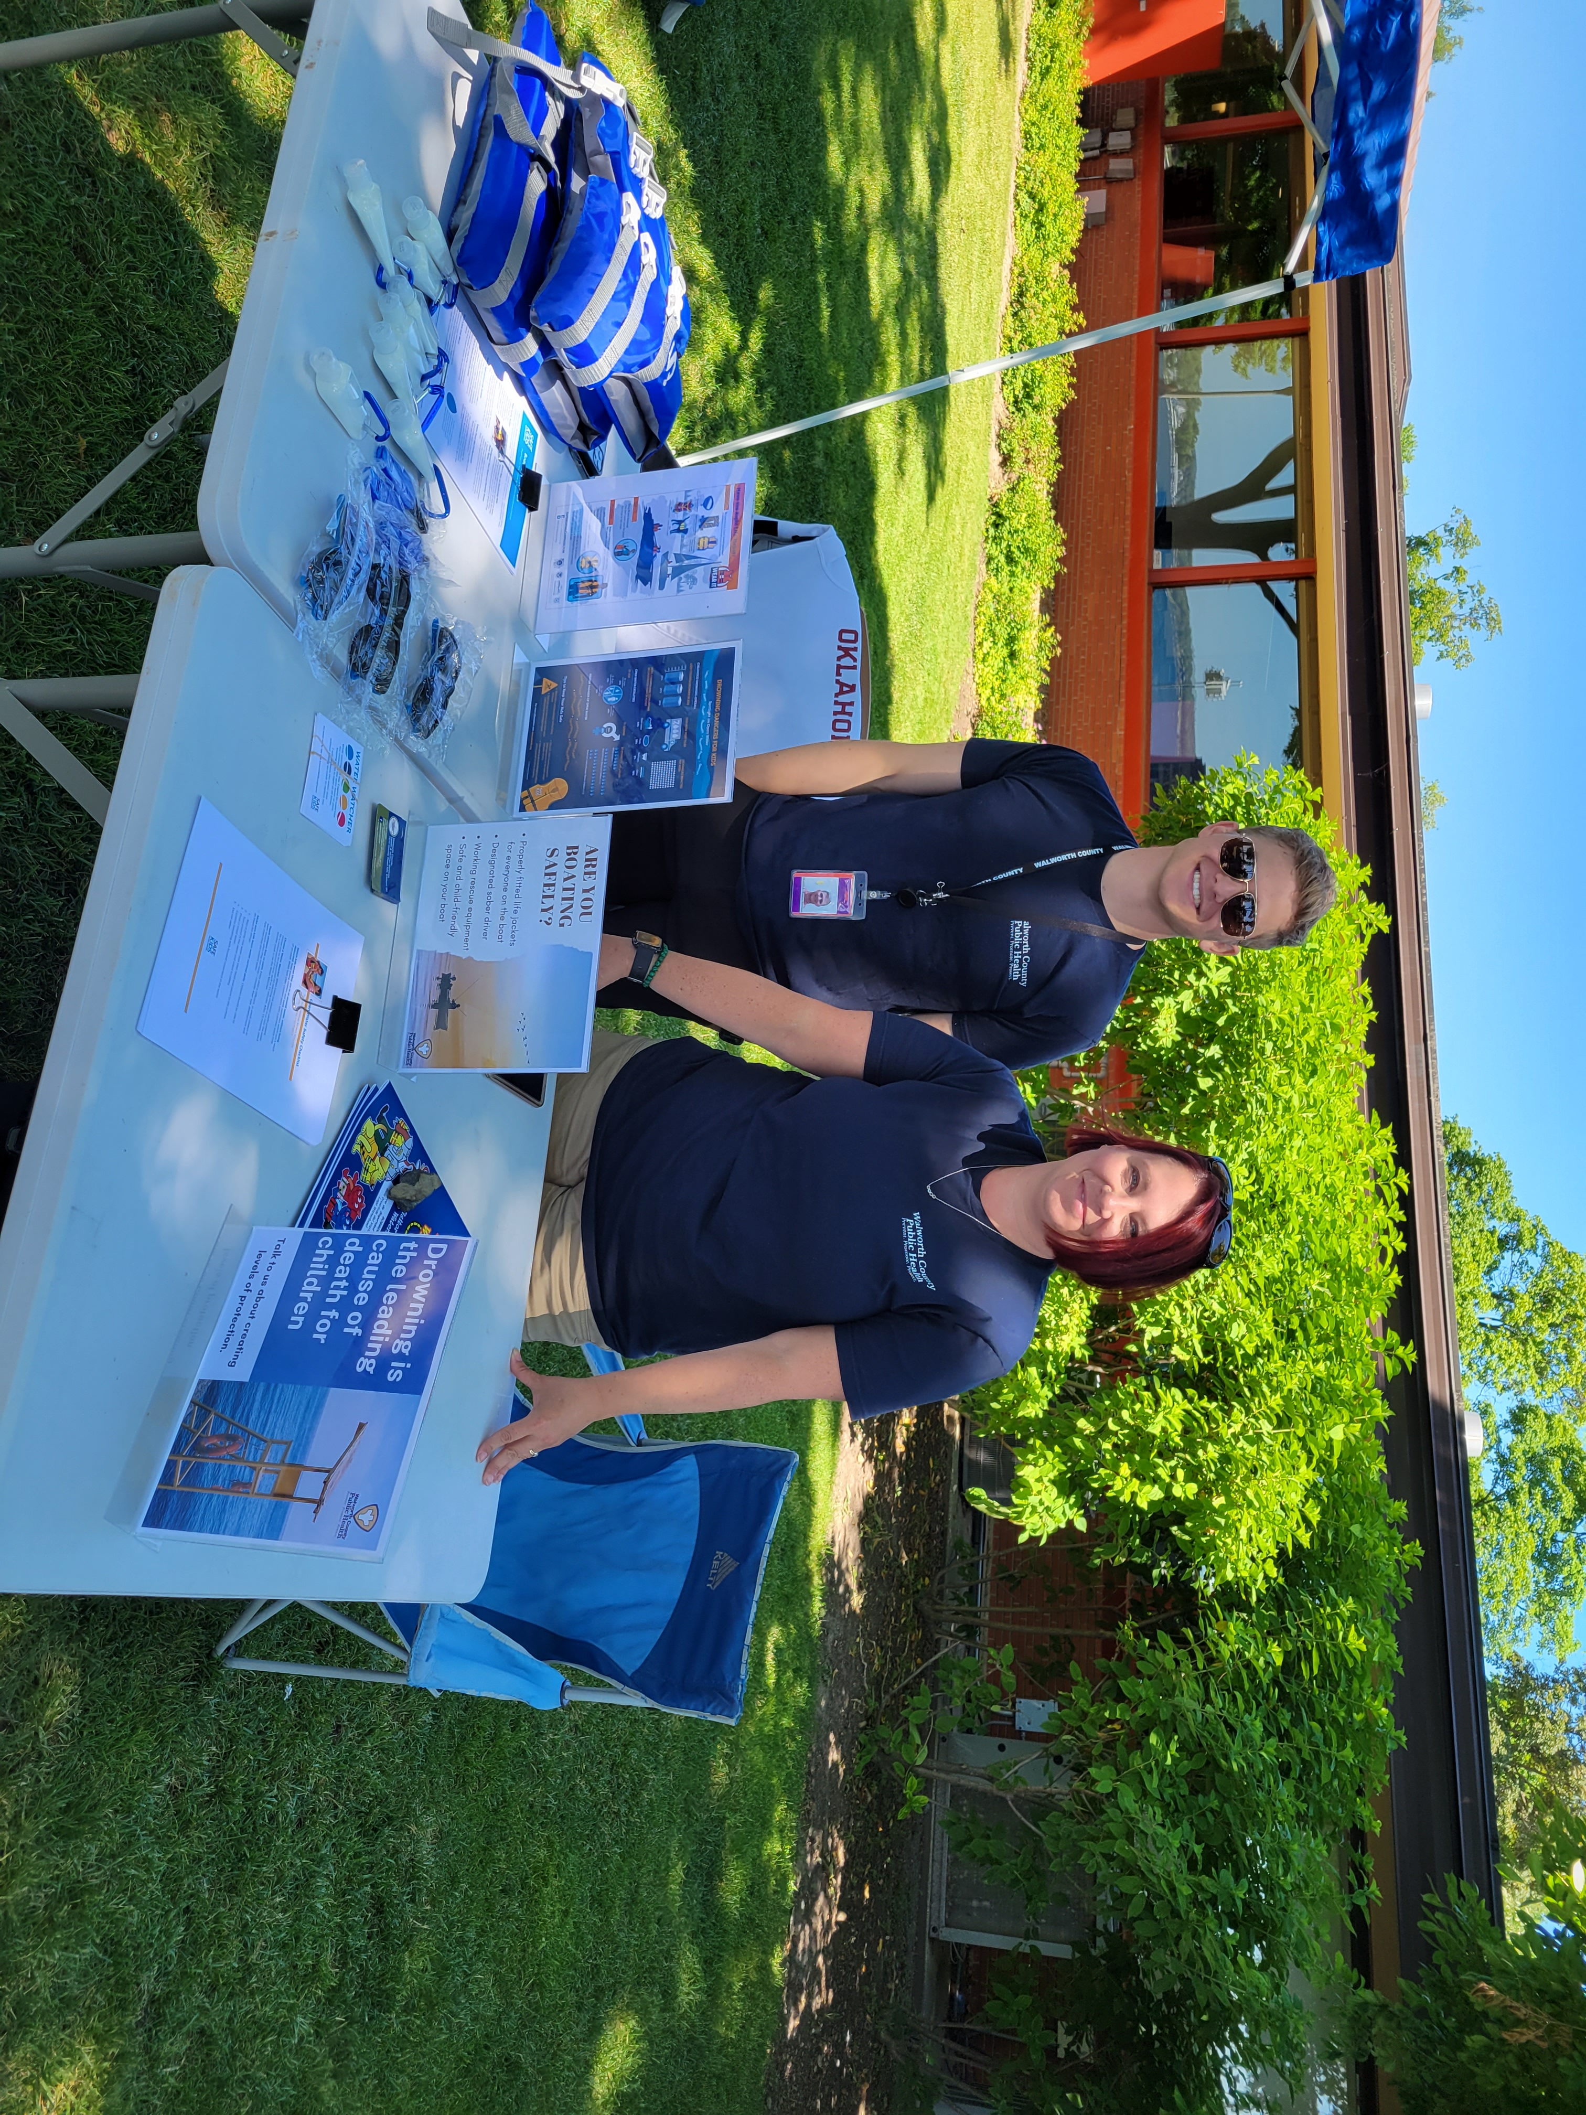
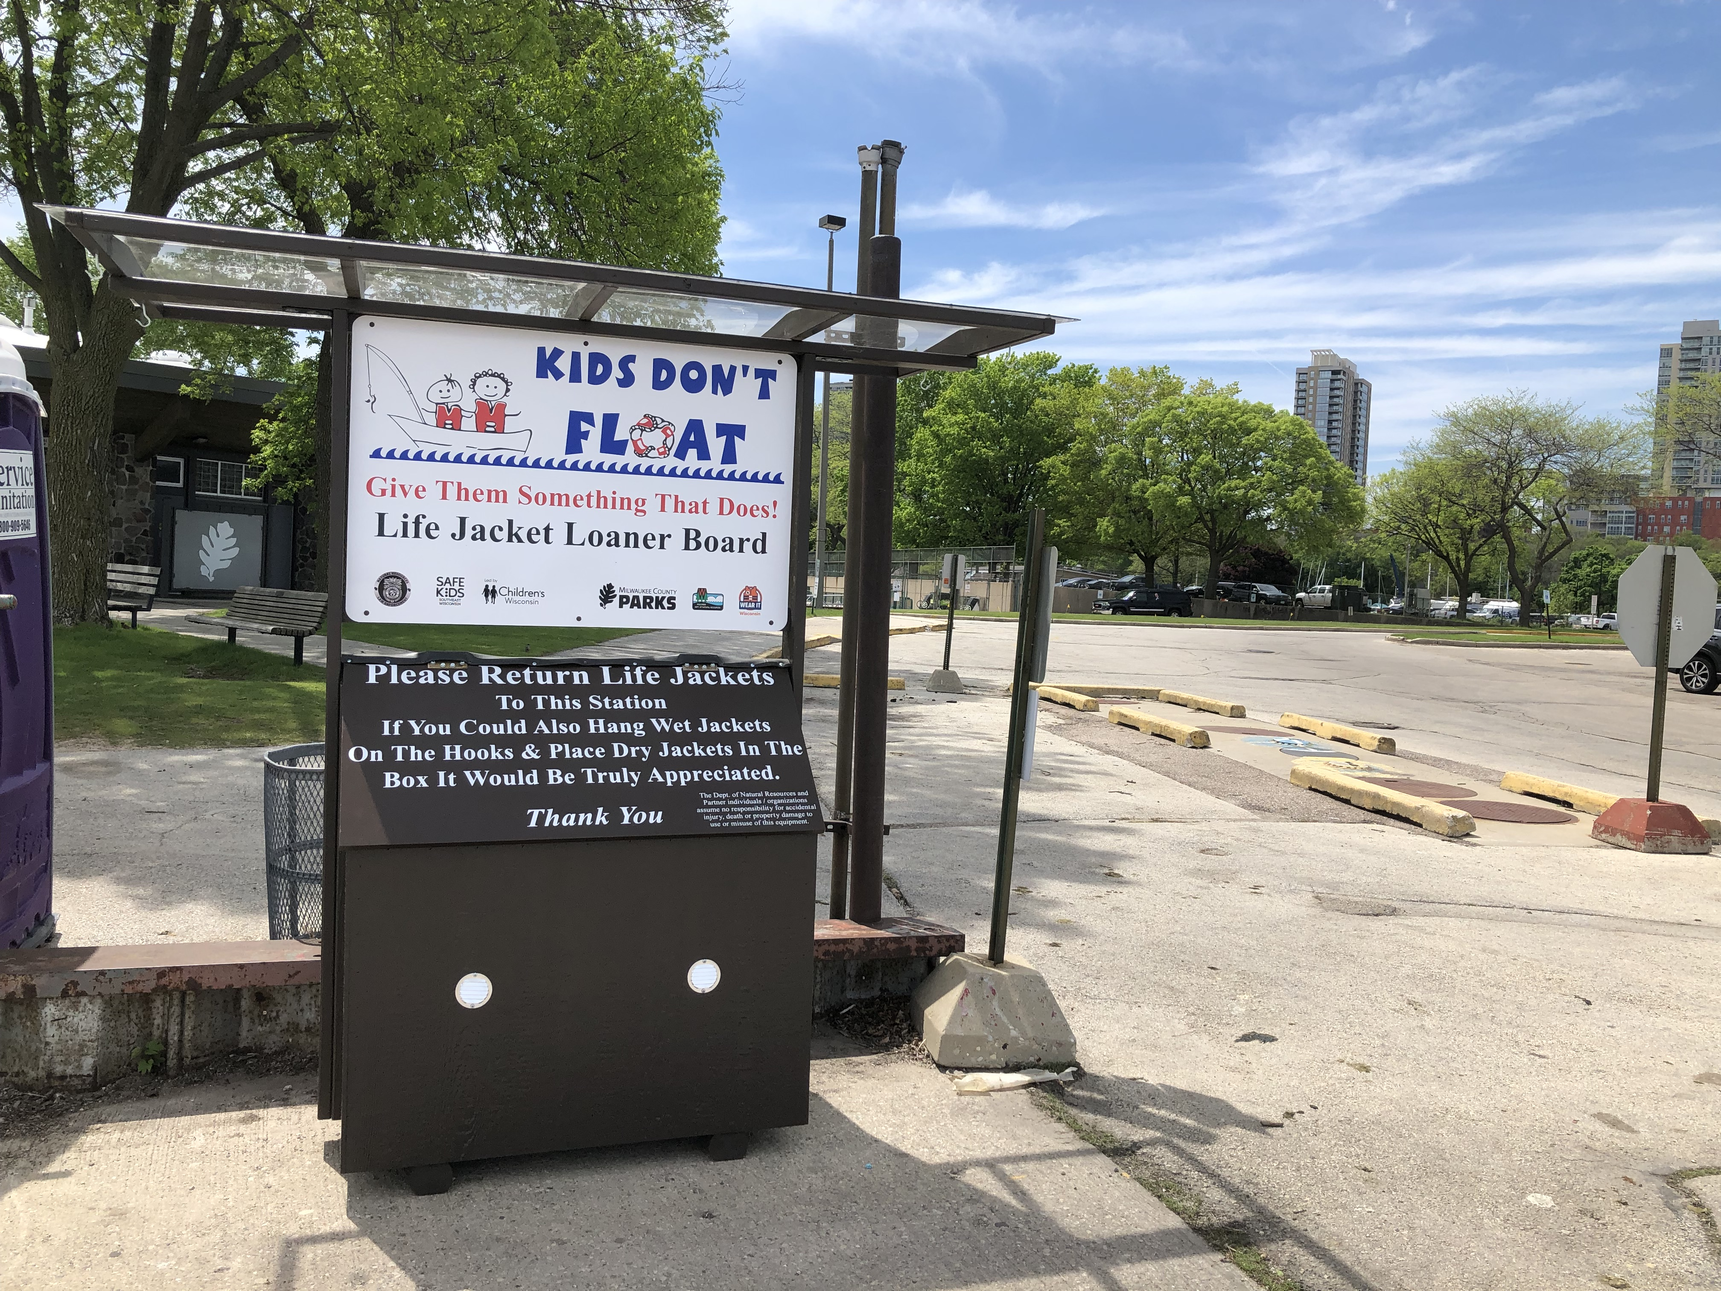
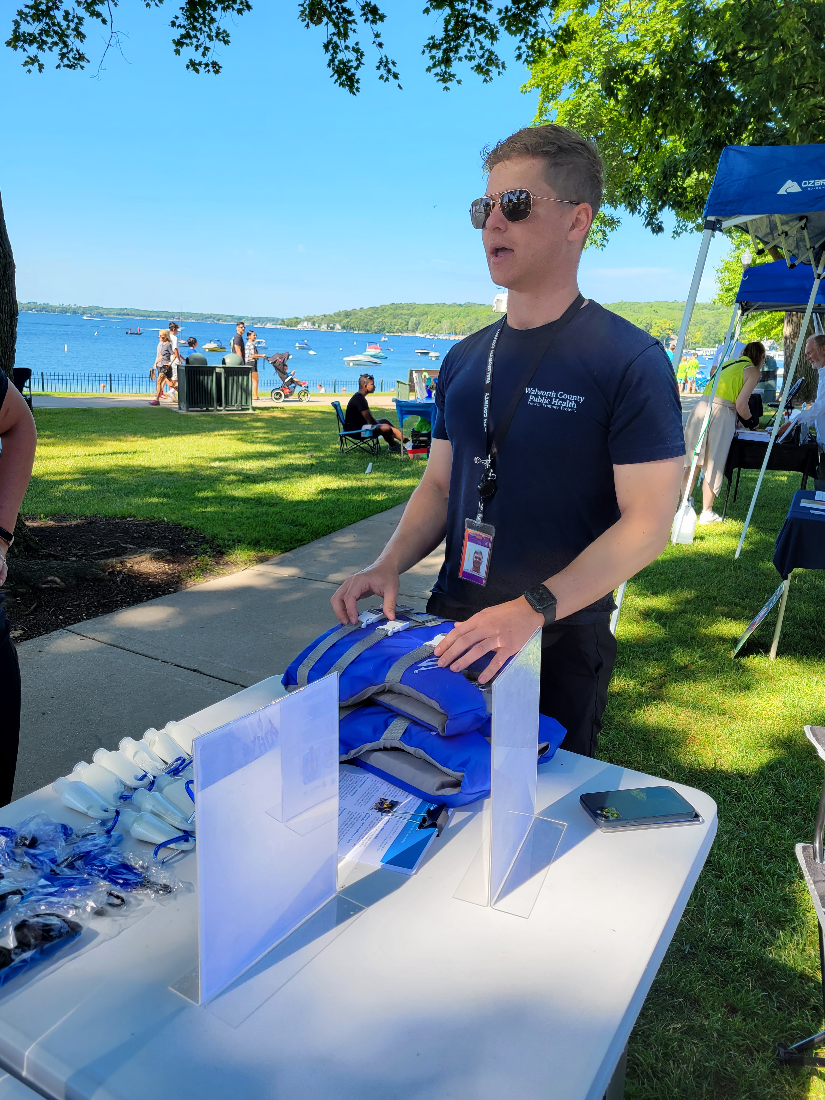
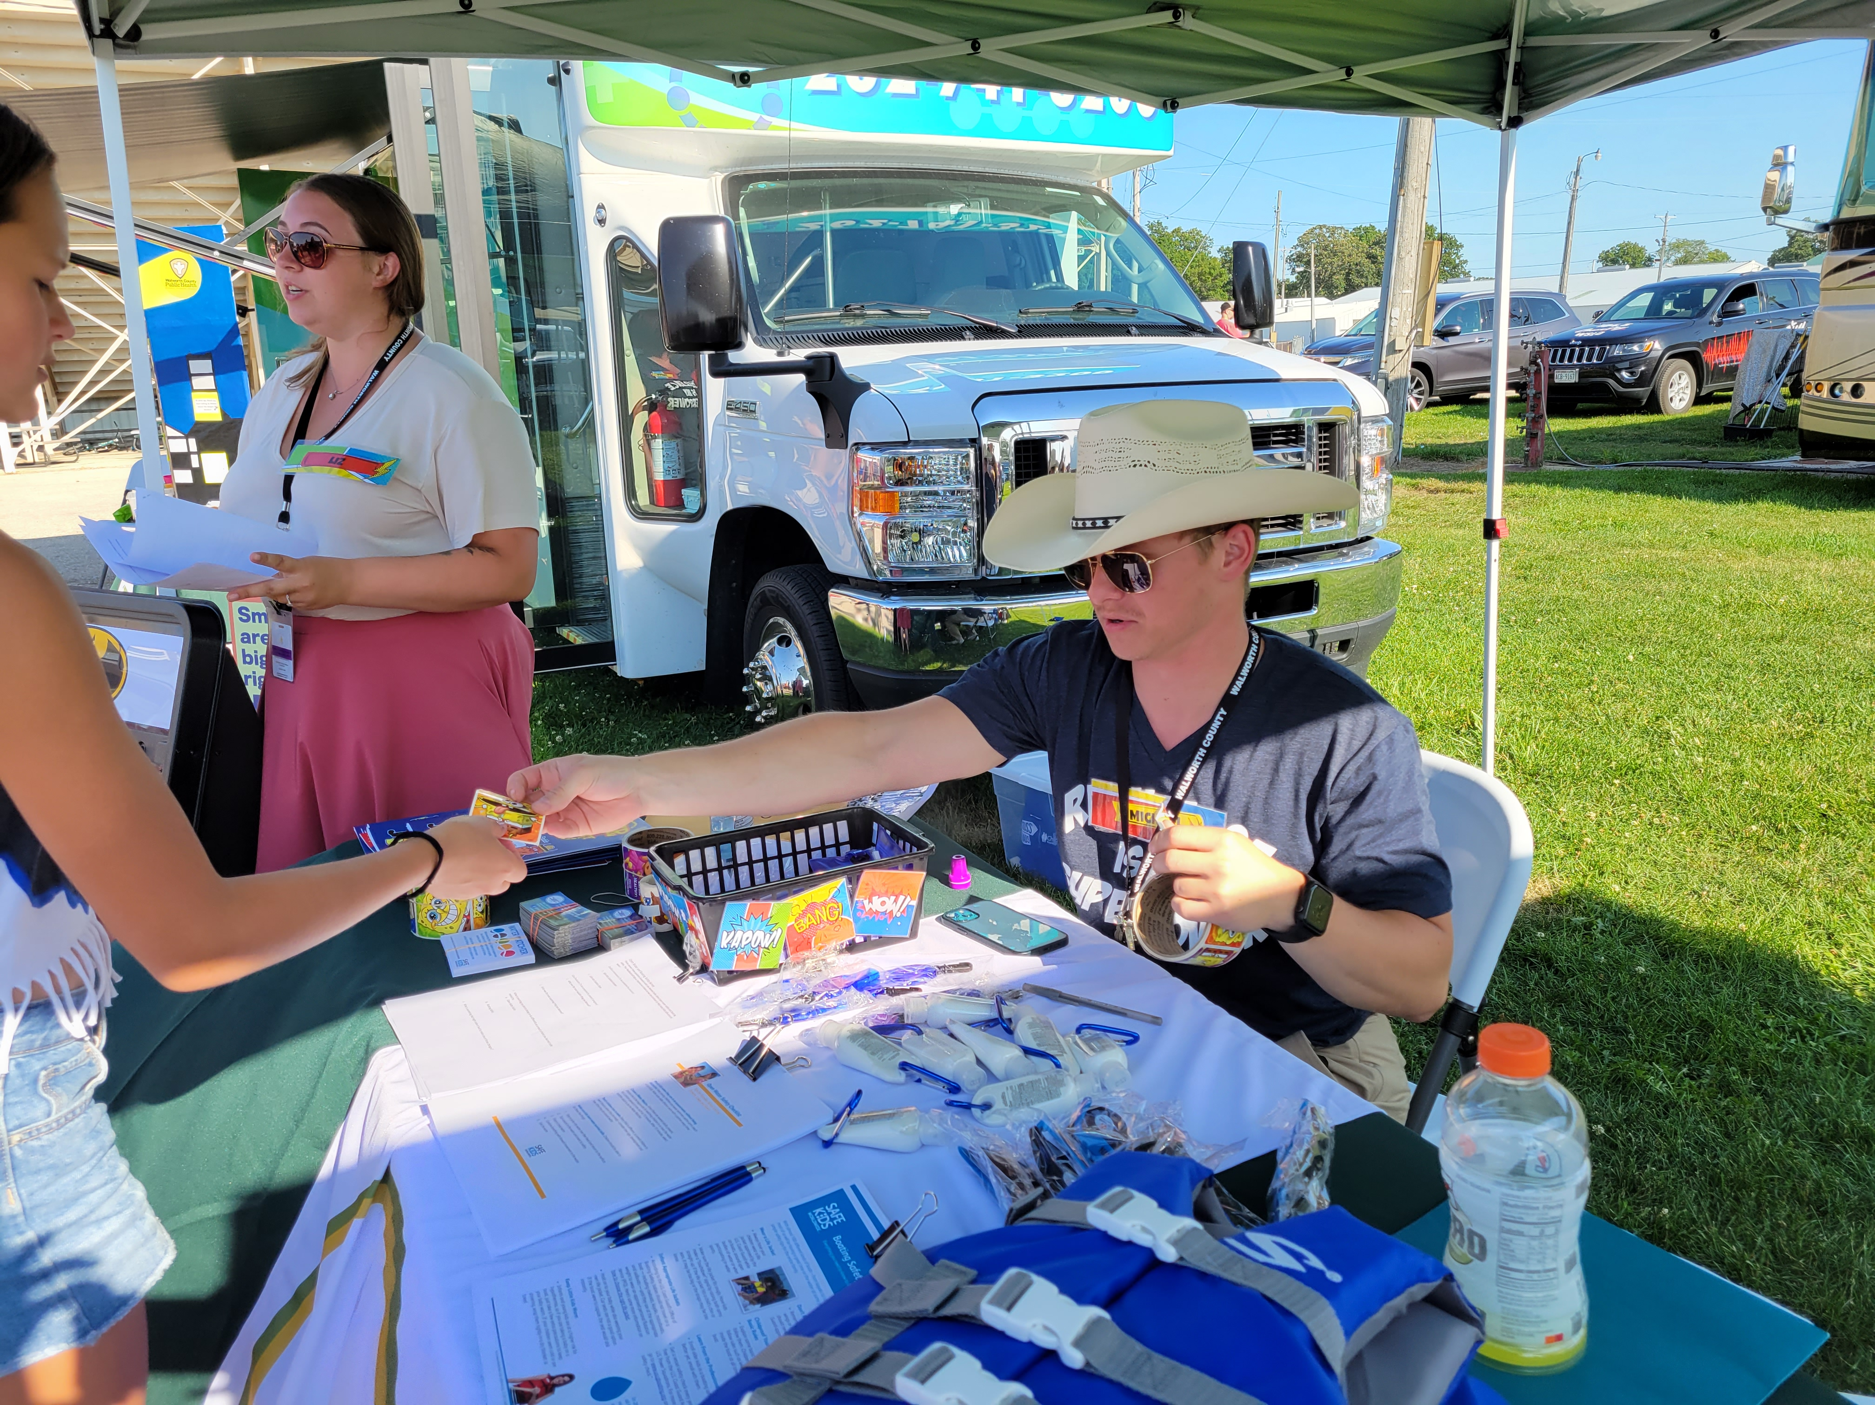
Water Safety Grant

